Slide 1

Shasta River Watershed Stewardship Report
Update for the Regional Board
June 29, 2017
Item No. 4
Eli Scott and Clayton Creager

Slide 2
Presentation Overview
TMDL Related Activities
Background on Shasta Stewardship
Stewardship Report Summary
Water Quality Status and Trends
Report Next Steps
TMDL Adaptive Management Next Steps

Slide 3
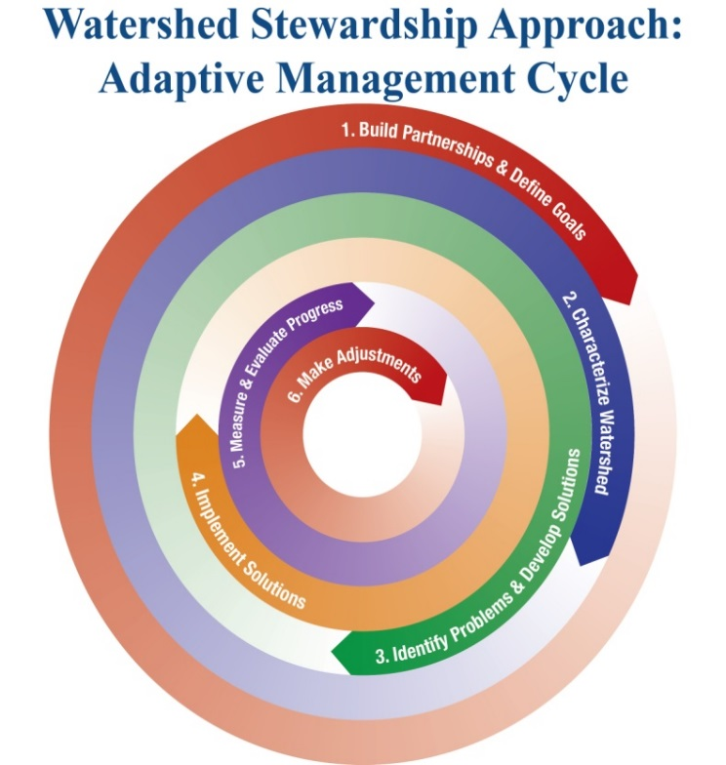
Benefits
Increases opportunities for collaboration and partnership
Leverages restoration and monitoring resources
More rigorously tracks progress over time

Slide 4
Shasta River TMDL Related Activities
Implementation of Waivers
Grant program projects
Efforts of partner agencies and NGOs
Actions of individual landowners
Watershed Stewardship
  Adaptive management
  Collaborative funding
  Monitoring network

Slide 5
Shasta River Watershed Stewardship Report
Partnerships
Watershed description and setting
Historical ecology
Water quality issues of concern
Catalogue of stewardship projects completed to date
Water quality status and trends
Adaptive management recommendations

Slide 6
Shasta River Watershed Stewardship Report
Collaborative work with partner input:
  Shasta Valley Resource Conservation District
  Regional Water Board
  California Conservation Corps Watershed Stewardship Program
    Nick Cusick
    Callie Grant
  California Department of Fish and Wildlife
  The Nature Conservancy
  USFWS / NOAA NMFS
  Klamath Basin Monitoring Program
  Others

Slide 7
Historical Ecology Analysis
Watershed conditions trajectory
Lines of evidence for reconciliation targets

Slide 8
Inventory of Watershed Stewardship Activities
Summarizes:
Riparian miles protected
Tailwater return follow projects (acre feet of water)
Impoundments removed
Riparian habitat restored
Other

Slide 9
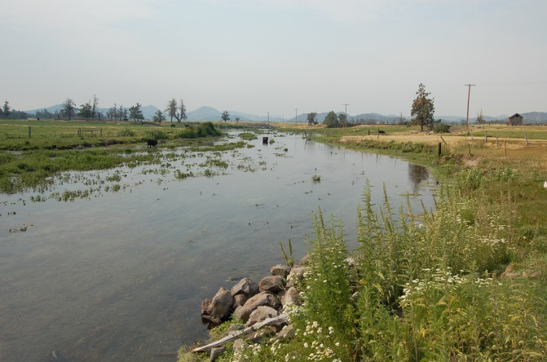
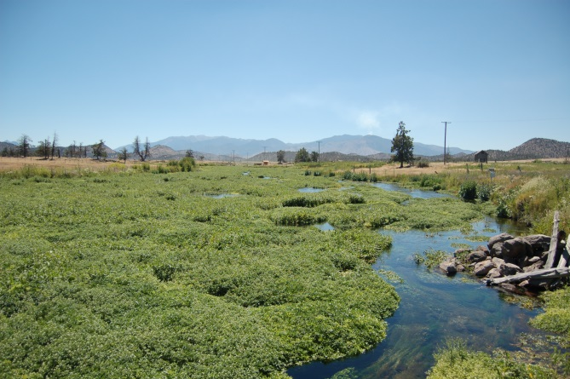
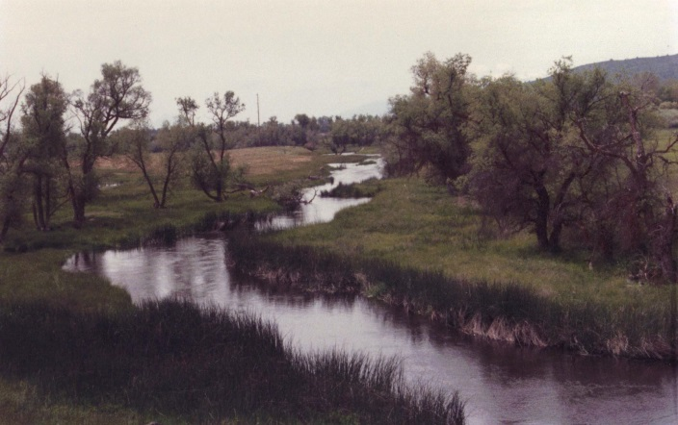
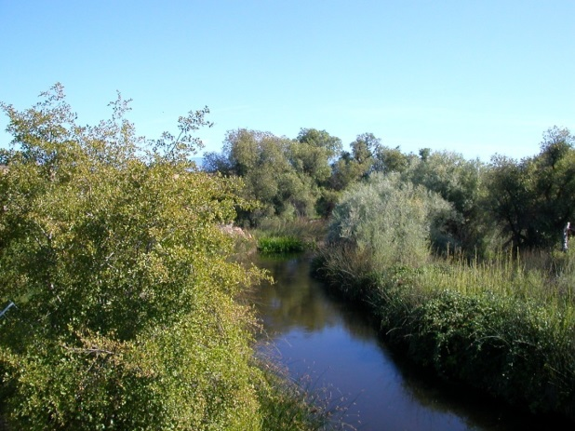
Assesses Mitigation Effectiveness
Big Springs Creek, 2008
Big Springs Creek, 2012
Montague-Grenada Bridge, 1993
Montague-Grenada Bridge, 2011

Slide 10
Data Analysis
Have stewardship and TMDL related activities resulted in quantifiable changes in water quality?
  Dissolved Oxygen
  Temperature

Slide 11
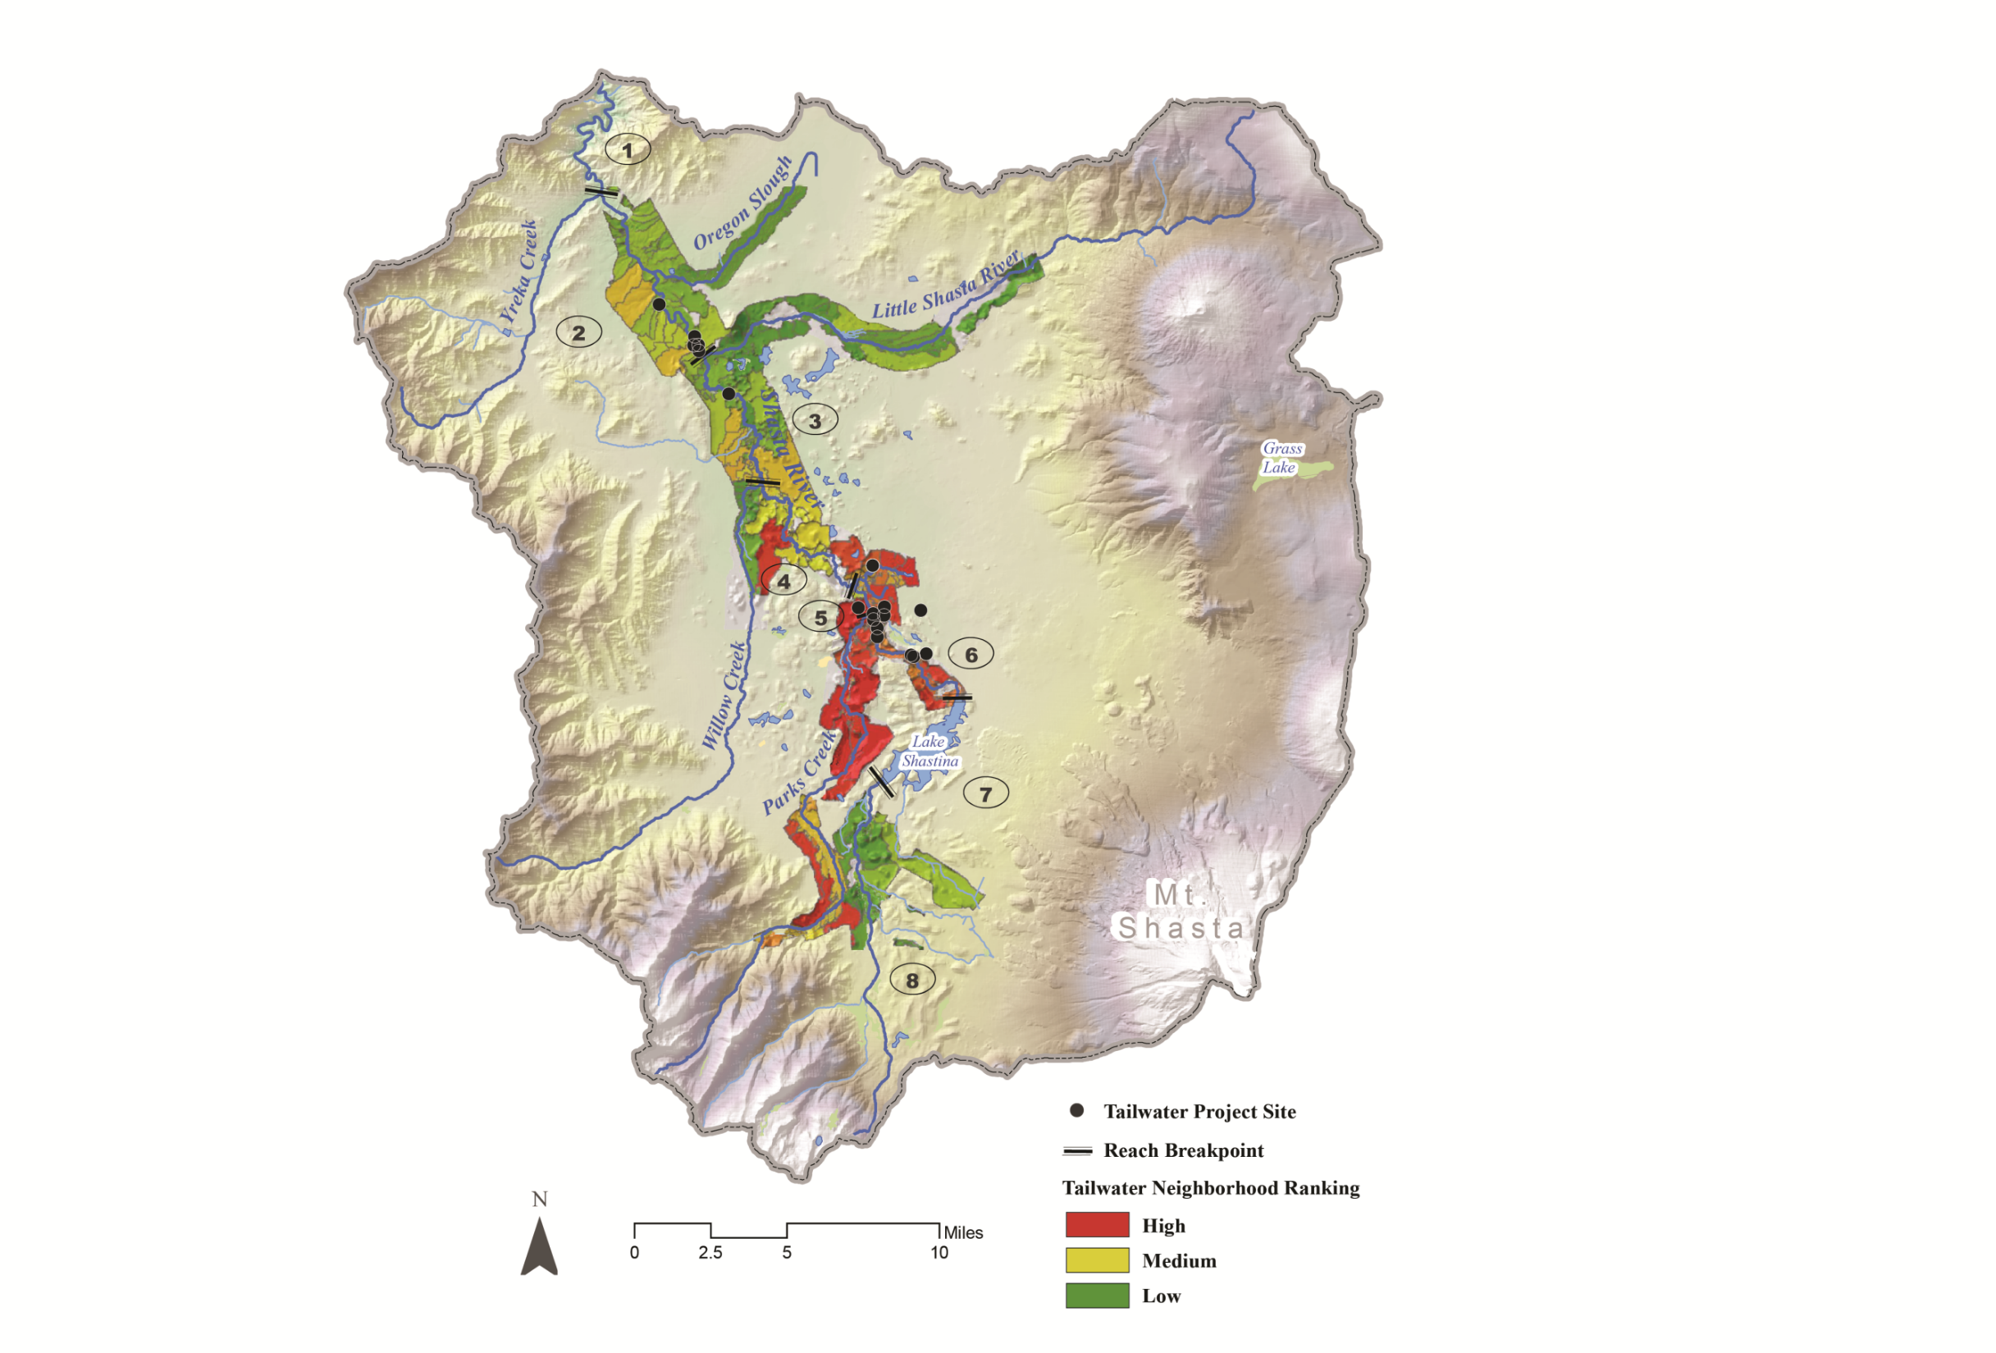
Tailwater Neighborhood Ranking (Aquaterra and SVRCD, 2013)
Notes:
Priorities are based on level of risk from land practices to water quality and the resource/habitat potential in the area. This map (SVRCD) shows priority rankings of different tailwater neighborhoods.
High: 4, 5, 6
Medium: 2, 3
Low: 1, 7, 8
We have funded the SVRCD to maintain a network of water quality monitoring points along the river, which has build a robust data set that can inform and refine our work in the watershed.

Slide 12
Dissolved Oxygen Objective – Basin Plan
“Dissolved Oxygen (DO) Concentrations shall conform to the following aquatic life requirements as specified.”
Water Quality Control Plan for the North Coast Region. Section 3 - Water Quality Objectives. Revised June 18, 2015. Adopted July 18, 2016.
Beneficial Use | Daily Minimum Objective (mg/L) | 7-Day Moving Average Objective (mg/L)
Marine Habitat (MAR) Inland Saline Water Habitat (SAL) | 5.0 | N/A
Warm Freshwater Habitat (WARM) | 5.0 | 6.0
Cold Freshwater Habitat (COLD) | 6.0 | 8.0
Spawning, Reproduction, and/or Early Development | 9.0 | 11.0
Notes:
An example of our adaptive management approach to review progress and prioritization, using basin plan objectives.

Slide 13
Dissolved Oxygen Analysis
Period examined: June 22 through September 30
Irrigation season after the onset of seasonal aquatic vegetation
Tailwater flows and temperatures are highest
Respiration is at its peak (aquatic plants and attached algae)
Over-summer rearing habitat is crucial
The metric examined is the percentage of days in the time period where the minimum observed dissolved oxygen falls below 6 mg/L. Years missing 15% or more days of data in the period examined were not considered.

Slide 14
Dwinell Montague-Grenada Mouth
Notes:
Results for the whole monitoring network in 2015 and 2016, to show which areas are sufficiently oxygenated and which areas have low DO.
High priority reaches still show impairment.
Evidence of improvement at the former Araujo dam site.
Mid to low priority reaches are doing pretty good - >hasn’t always been that way.

Slide 15
Tailwater Neighborhood Ranking (Aquaterra and SVRCD, 2013)
Araujo Dam Site
Montague-Grenada Bridge
Nelson Ranch
Notes:
Back to the map – here are the three monitoring points with the longest record.
Good spatial spread – one at the end of the high priority reach, two in the low-medium priority reaches.

Slide 16
Tailwater Neighborhood Ranking (Aquaterra and SVRCD, 2013)
DO Analysis Days < 6 ppm
Notes:
Nelson Ranch – downstream from the high priority areas (confluence of Big Springs and Parks Creeks).
2016 was pretty decent, but impairment is highly variable, doesn’t show a statistically significant trend, but it shows what could be an emerging trend.
Uptick in efforts in the last few years.

Slide 17
Tailwater Neighborhood Ranking (Aquaterra and SVRCD, 2013)
DO Analysis Days < 6 ppm
Notes:
Location at the Montague-Grenada Bridge. This is a statistically significant decreasing trend. No impairment for this beneficial use target in 2016 during the period of record.
Lots of stewardships projects implemented between 2008 and 2015.
Medium priority.
Likely the scale of projects implemented matched the level of impact appropriately.

Slide 18
Tailwater Neighborhood Ranking (Aquaterra and SVRCD, 2013)
DO Analysis Days < 6 ppm
Notes:
Araujo Dam Site. Weak trend, not statistically significant. Variable DO levels. Minimal stewardship activities.
Low to medium priority.
Level of work not commensurate to level of impairment.
More work needed here.
Impairment, while linked, is still site-specific. If conditions are good upriver, that doesn’t mean they will be downriver.

Slide 19
Temperature Assessment
Big Springs Creek
Shasta River at Highway 3 Bridge
MWMT = Maximum weekly maximum temperature.
ADMT = Average daily maximum temperature.
Notes:
Big Springs – Implemented many of the measures we would consider in compliance with the waiver – significant temperature improvement.
Mainstem – still shows a statistically significant increasing trend for temperature.

Slide 20
Stewardship Report
Next Steps
Complete internal and partner review
Submit to Klamath Tracking and Accounting Program (KTAP)
Present to stakeholder groups
Post to Klamath Basin Monitoring Program (KBMP) Watershed Stewardship page
Manage Adaptively!
Notes:
Big Springs – Implemented many of the measures we would consider in compliance with the waiver – significant temperature improvement.
Mainstem – still shows a statistically significant increasing trend for temperature.

Slide 21
TMDL Adaptive Management
Continued implementation of Waivers
Continue to support stewardship projects such as: spring rehabilitation, tailwater reduction, riparian protection strategies
Support model development to assess flow and temperature restoration scenarios
Support and participate in CA Water Action Plan program for Shasta River

Slide 22
Questions & Comments

